Slide 1

Colorado State University
FISH Processing
Luis Aguilera
50% Tim Stasevich Group
50% Brian Munsky Group
Notes:
Today I am going to talk to you about the work Luis and I have been doing lately. We have been working on simulating cell data of single-cell mRNA translation.

Slide 2
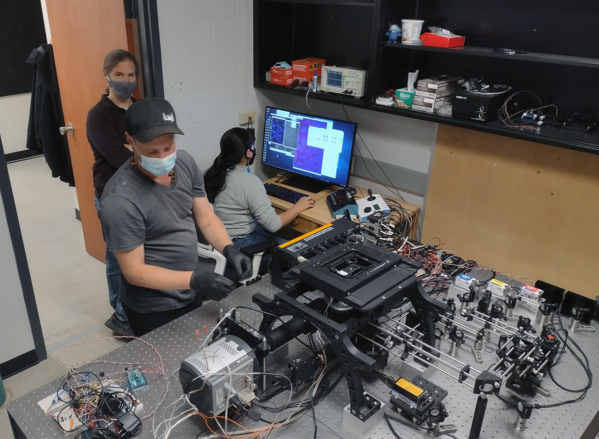





Justification
samples
terminator scope
(lots of) data
1 (FISH) stack images / 5sec
720 stack / hr
1 stack ~ 100Mb
~72 Gb / hr
storage?
transfer data?
image processing time?
computer?
Notes:
In rSNAPed, the simulated software, we are implementing a fully automated pipeline that allows the analysis of single-molecule data sets. rSNAPed models single-mRNA translation using observable fluorescence and mechanistic interpretation.
Segmentation is the first step of the process. Cellpose is a cellular segmentation algorithm written in Python. It is an open-source package that is freely available. It allows us to transform raw simulated image data into interpretable data that we can apply to our experiments. The first step in image segmentation is to segment the images into cell bodies. This is relatively easy when the cells are sufficiently separated from each other, but can become more difficult if the cells are tightly packed together. A mask is then created around the cell bodies with pixels, and all of the pixels are trying to point towards the center. All of these pixels conglomerate as one cell.
The second part of the image processing pipeline includes Trackpy, a python package that tracks dots. It allows us to track fluorescent antibody-based probes that are bound to nascent proteins on single-RNA cells only visible by their beacons of light. The image is represented as a numpy array of intensities. We end up with a field of tracked particles. Results are given as data frames that can be easily saved.
After tracking the spots, we quantify the data by comparing the intensity distributions. We can quantify intensity in every spot. This is done in one method by using disk and donut. You take a tracked spot, and travel a disk and a donut outside of the spot. After drawing a donut outside of the spot, you can calculate the mean intensity of donut and the intensity in the disk.
We then classify these spot intensities based on their color channels. The images have three different color channels: red, blue, and green. We can classify the spots through either single color channels of red, blue, and green, or the combinations of them.
Every part of this pipeline is connected to the simulated cell. It allows us to generate large amounts of data to fully automate the pipeline.

Slide 3
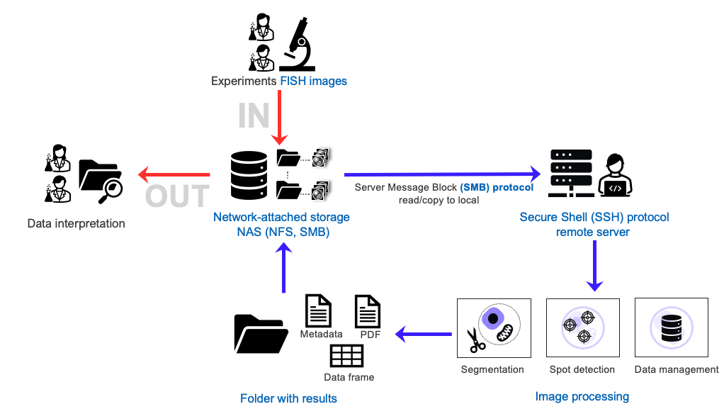
Example: working with FISH images

Slide 4


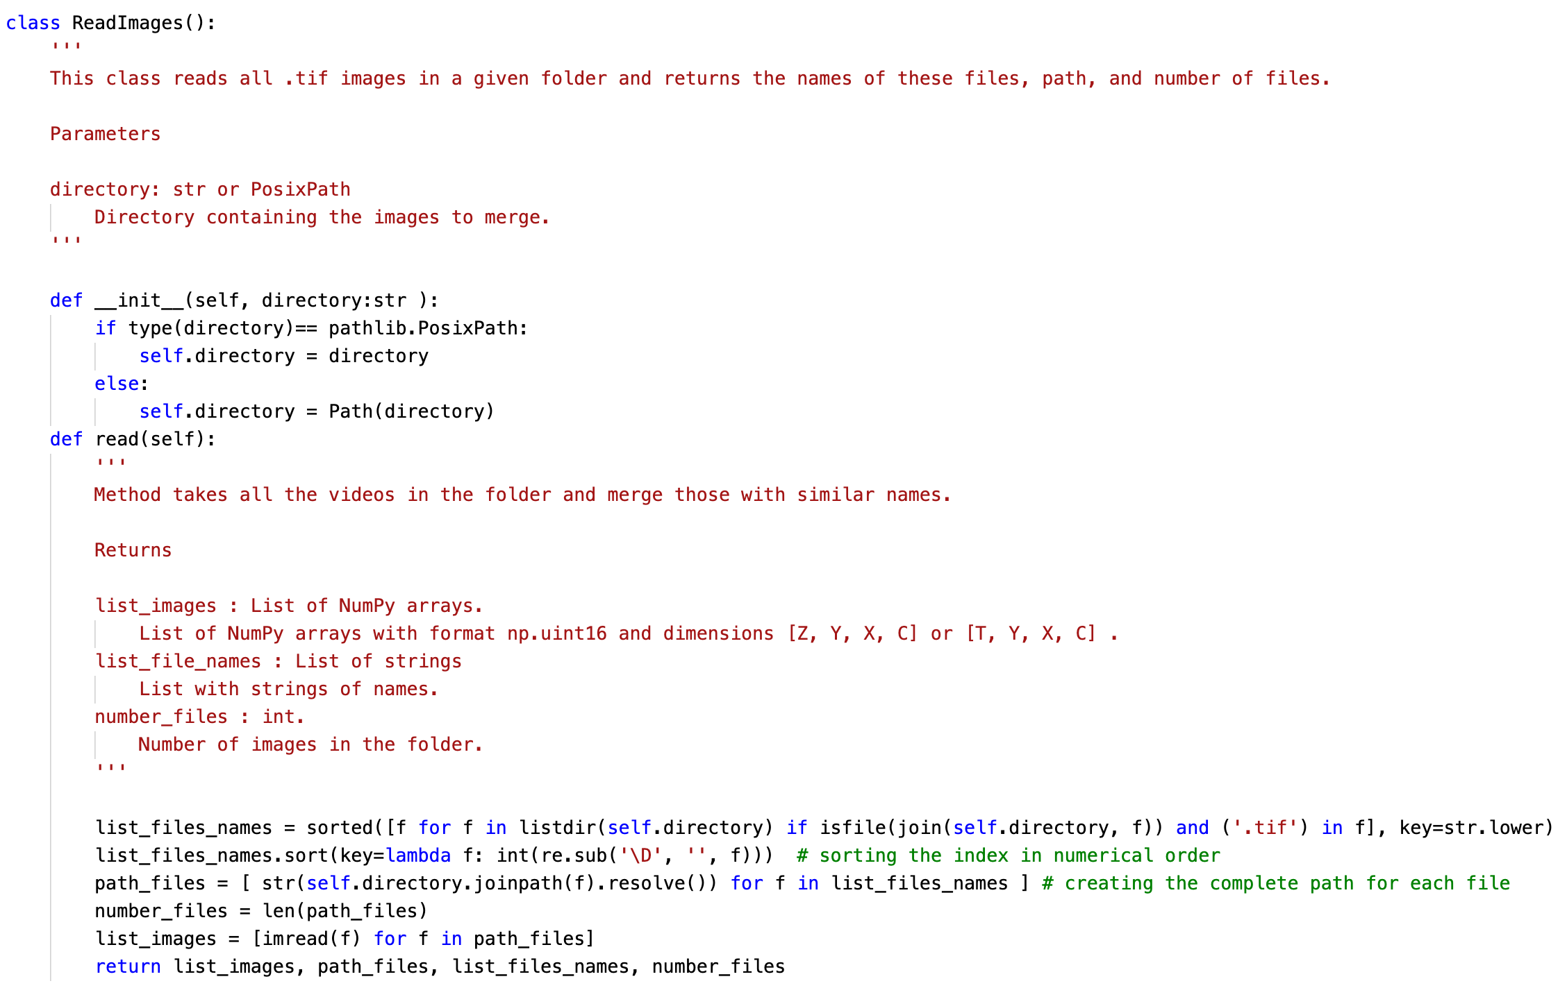
Documentation
comment →
→ documentation
code →
comment →
→ documentation
code →

Slide 5
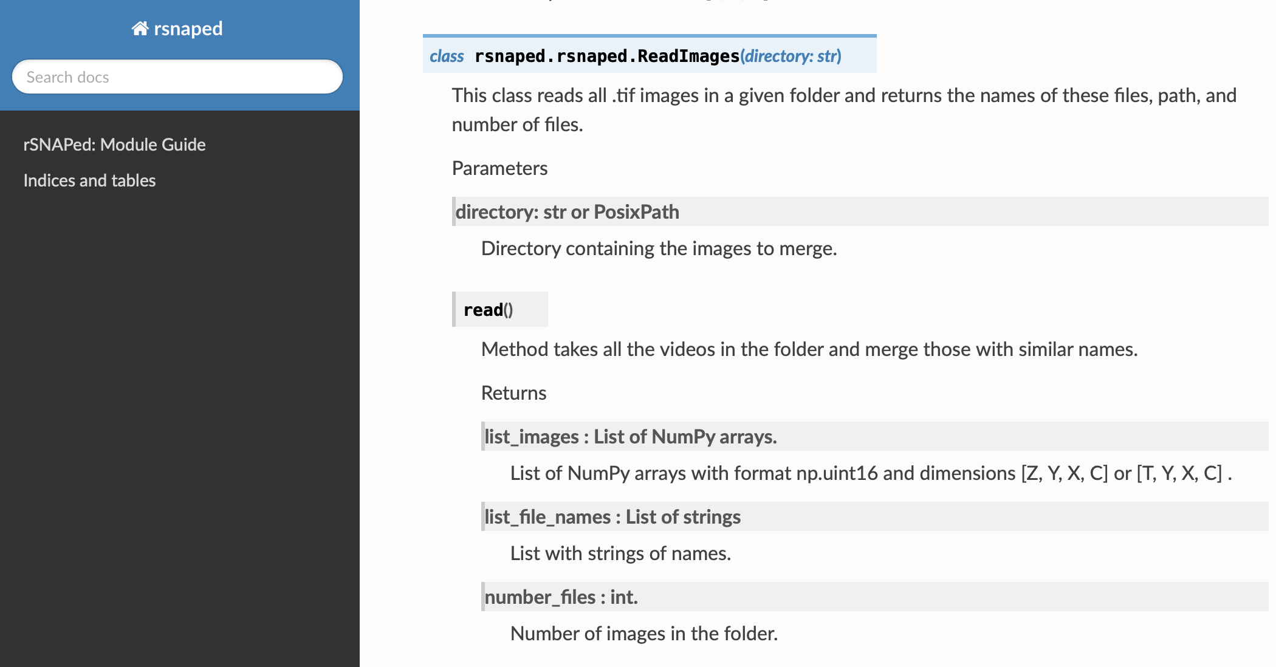
Documentation

Slide 6





Version control + environments = publication quality code
Git-Github
Python virtual environment
new features
version1
version2
master
other user features
conda activate vir_env
pip install croparray
Notes:
In rSNAPed, the simulated software, we are implementing a fully automated pipeline that allows the analysis of single-molecule data sets. rSNAPed models single-mRNA translation using observable fluorescence and mechanistic interpretation.
Segmentation is the first step of the process. Cellpose is a cellular segmentation algorithm written in Python. It is an open-source package that is freely available. It allows us to transform raw simulated image data into interpretable data that we can apply to our experiments. The first step in image segmentation is to segment the images into cell bodies. This is relatively easy when the cells are sufficiently separated from each other, but can become more difficult if the cells are tightly packed together. A mask is then created around the cell bodies with pixels, and all of the pixels are trying to point towards the center. All of these pixels conglomerate as one cell.
The second part of the image processing pipeline includes Trackpy, a python package that tracks dots. It allows us to track fluorescent antibody-based probes that are bound to nascent proteins on single-RNA cells only visible by their beacons of light. The image is represented as a numpy array of intensities. We end up with a field of tracked particles. Results are given as data frames that can be easily saved.
After tracking the spots, we quantify the data by comparing the intensity distributions. We can quantify intensity in every spot. This is done in one method by using disk and donut. You take a tracked spot, and travel a disk and a donut outside of the spot. After drawing a donut outside of the spot, you can calculate the mean intensity of donut and the intensity in the disk.
We then classify these spot intensities based on their color channels. The images have three different color channels: red, blue, and green. We can classify the spots through either single color channels of red, blue, and green, or the combinations of them.
Every part of this pipeline is connected to the simulated cell. It allows us to generate large amounts of data to fully automate the pipeline.

Slide 7
Version control + environments = publication quality code

Slide 8
Version control + environments = publication quality code

Slide 9
Version control + environments = publication quality code

Slide 10





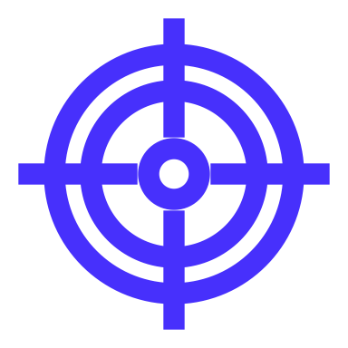









1 open-source programming language
Experimental data
Image Processing
Modeling
Visualization and Interpretation
x₂
Gene construct
x₁
x₃
Segmentation
Spot detection
and tracking
Data management
Model selection
+
Biophysical parameters
Simulated data
Microscope images
cellpose
trackpy
Big-FISH
x-array
pycro-manager
rsnaped
rsnapsim
croparray
Notes:
In rSNAPed, the simulated software, we are implementing a fully automated pipeline that allows the analysis of single-molecule data sets. rSNAPed models single-mRNA translation using observable fluorescence and mechanistic interpretation.
Segmentation is the first step of the process. Cellpose is a cellular segmentation algorithm written in Python. It is an open-source package that is freely available. It allows us to transform raw simulated image data into interpretable data that we can apply to our experiments. The first step in image segmentation is to segment the images into cell bodies. This is relatively easy when the cells are sufficiently separated from each other, but can become more difficult if the cells are tightly packed together. A mask is then created around the cell bodies with pixels, and all of the pixels are trying to point towards the center. All of these pixels conglomerate as one cell.
The second part of the image processing pipeline includes Trackpy, a python package that tracks dots. It allows us to track fluorescent antibody-based probes that are bound to nascent proteins on single-RNA cells only visible by their beacons of light. The image is represented as a numpy array of intensities. We end up with a field of tracked particles. Results are given as data frames that can be easily saved.
After tracking the spots, we quantify the data by comparing the intensity distributions. We can quantify intensity in every spot. This is done in one method by using disk and donut. You take a tracked spot, and travel a disk and a donut outside of the spot. After drawing a donut outside of the spot, you can calculate the mean intensity of donut and the intensity in the disk.
We then classify these spot intensities based on their color channels. The images have three different color channels: red, blue, and green. We can classify the spots through either single color channels of red, blue, and green, or the combinations of them.
Every part of this pipeline is connected to the simulated cell. It allows us to generate large amounts of data to fully automate the pipeline.

Slide 11






Automation
Non-automated (manual) process
selected parameter(s)
Target (#spots)
tuning
parameters
Image(s)
large process(es)
Segmentation/tracking
Process parameters
Data

Slide 12




Automation
Automated process (Optimization + ML)
100s cells
1000s spots
pipeline-CLI
automated data management
Segmentation
1
Tracking
2
Quantification
¹ Automatic parameter tuning
² Automatic decision taking if an analysis fails
CLI : Command Line Interface

Slide 13
Luis Aguilera, Brian Munsky and Tim Stasevich.

